Slide 1

Project Title: Self-hosted Video Conferencing
ENS 491-492 – Graduation Project Final Presentation
GROUP MEMBER: MERT ALİ ÇELIK SUPERVISOR(S): AYHAN BOZKURT
DATE: 30.05.2024

Slide 2

Executive Summary: Secure Open-Source Video Conferencing
Core Issue: Need for secure, reliable, and cost-effective video conferencing. Privacy and security concerns with Jitsi Meet.
Project Aim: Develop an open-source video conferencing software. Prioritize user privacy and security.
Approach: Adaptation for enhanced privacy, robust security. Hosted on Linux for secure, flexible development.
Methodology: Comprehensive analysis of open-source tools. User-friendly interface with scalable performance. Rigorous development and extensive testing.
Key Findings: Feasible to create a competitive open-source video conferencing tool. Effective for users prioritizing privacy and security.

Slide 3
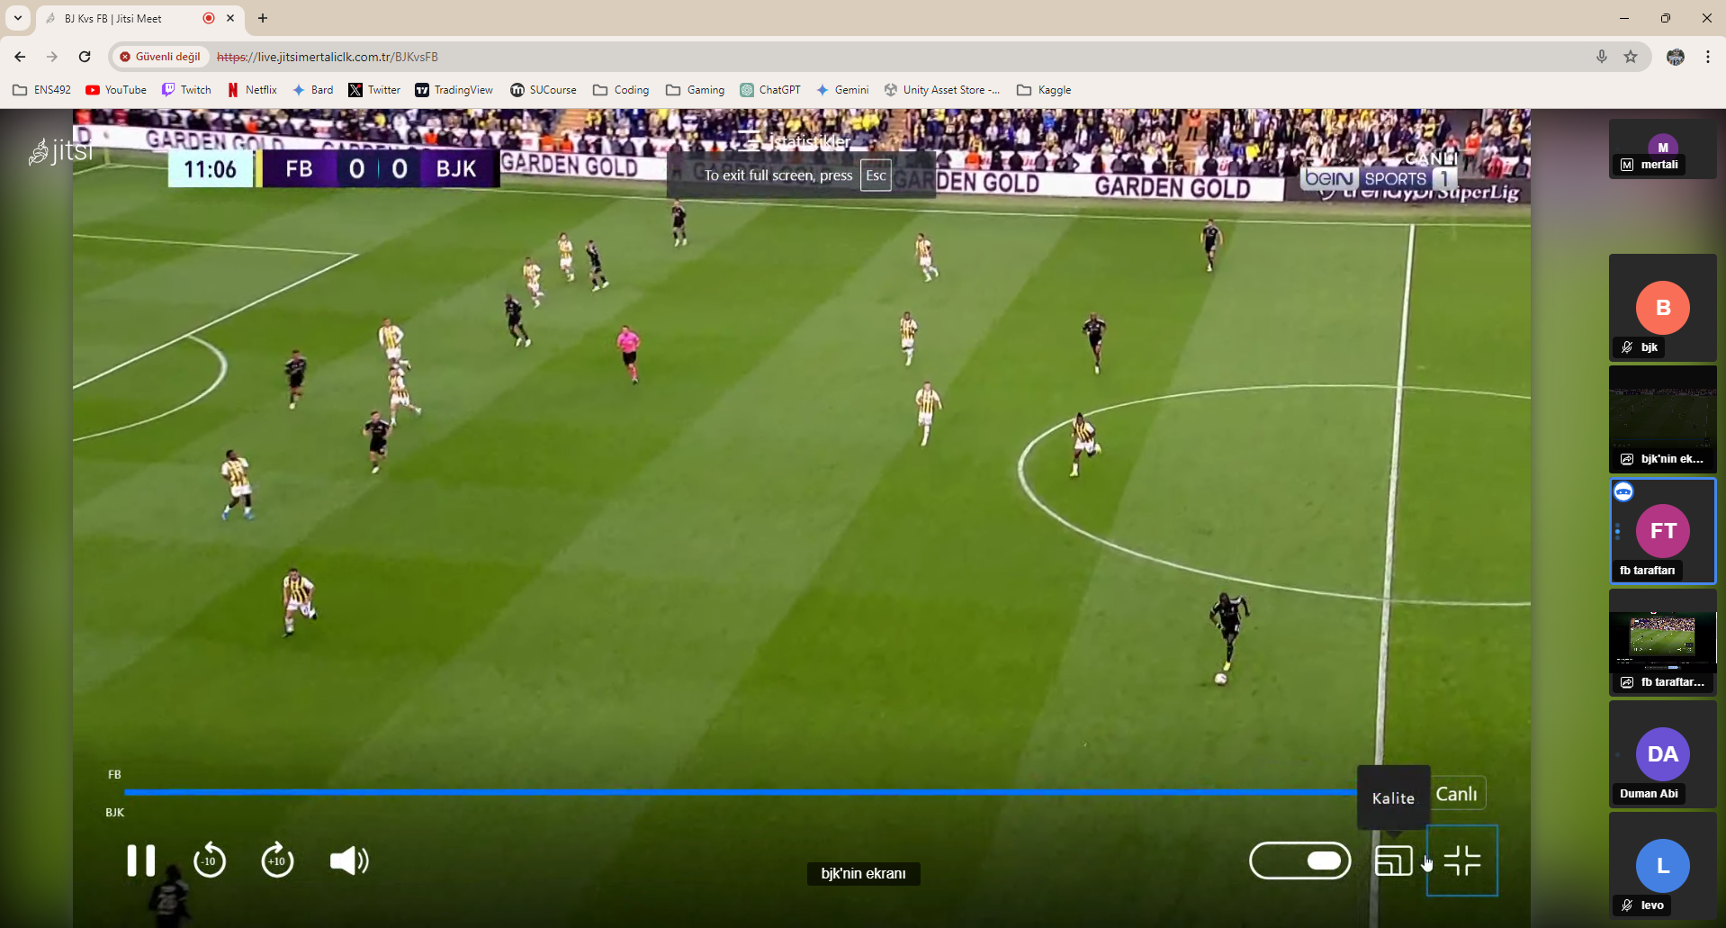
Problem Statement
Original Problem: Demand surge for video conferencing, privacy, and security concerns with existing tools.
Goal: Enhance digital communication privacy and security, leveraging opensource technologies.

Slide 4
Objectives/Tasks
Installation: Set up meeting tools and dependencies on a Linux host.
Customization: Tweak software to meet user requirements.
Storage Testing: Assess needs and performance during multiple recording sessions.
Network Testing: Examine requirements for multiple attendees.
Performance Analysis: Analyze CPU/RAM usage and speed with different size of groups.

Slide 5
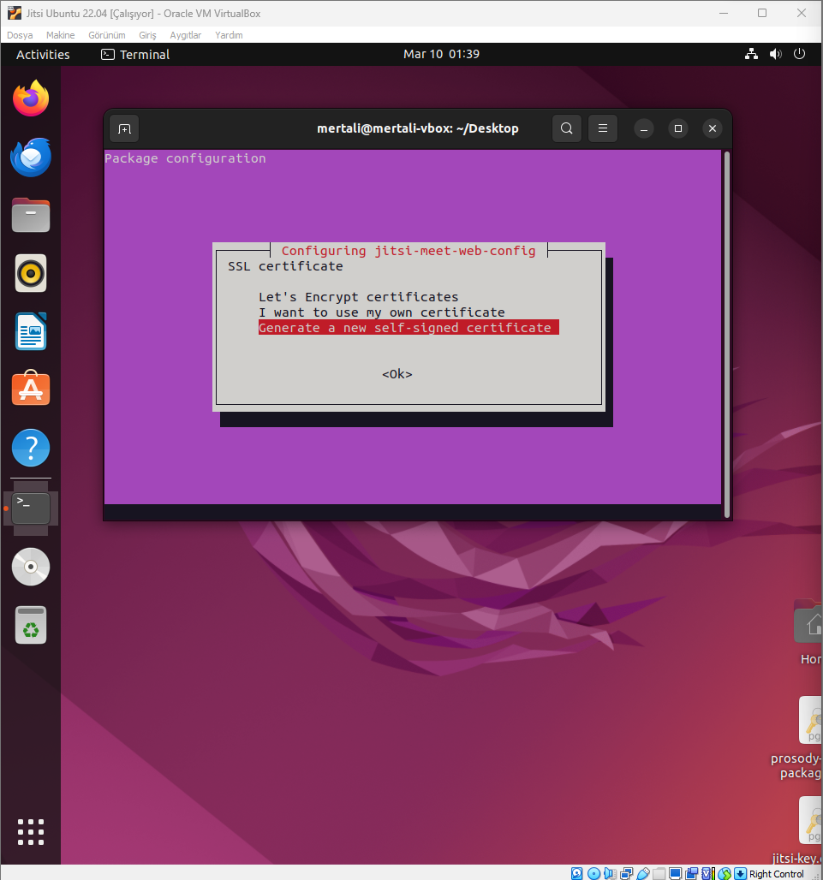
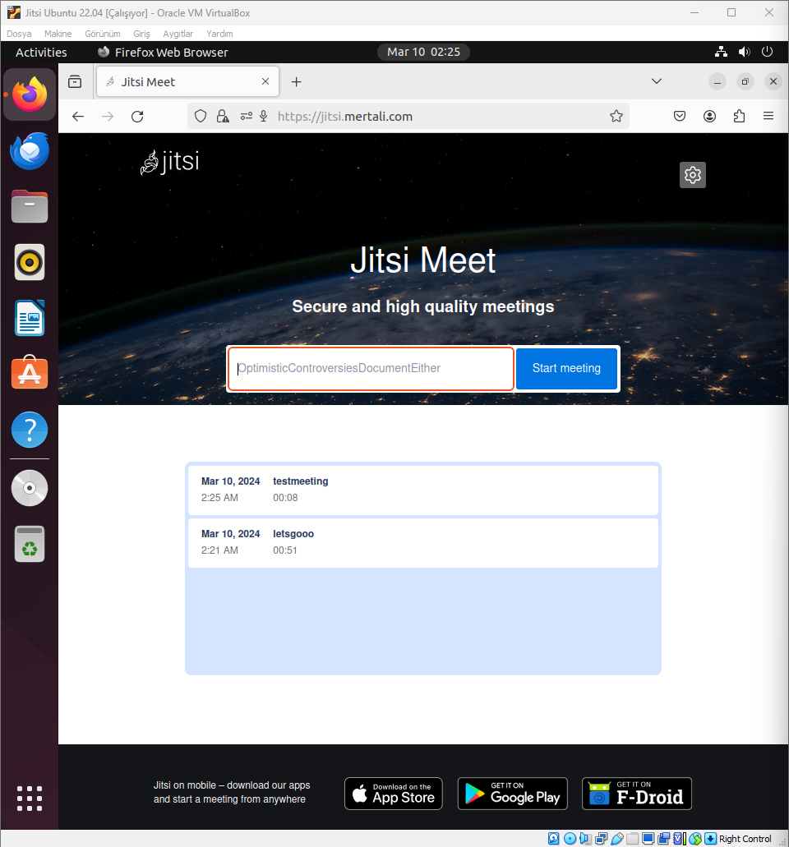

Slide 6
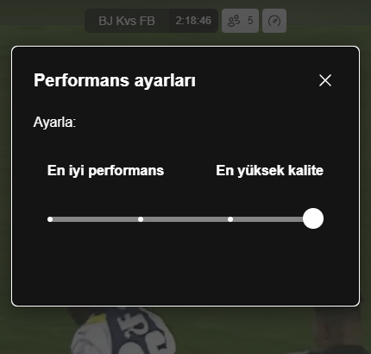
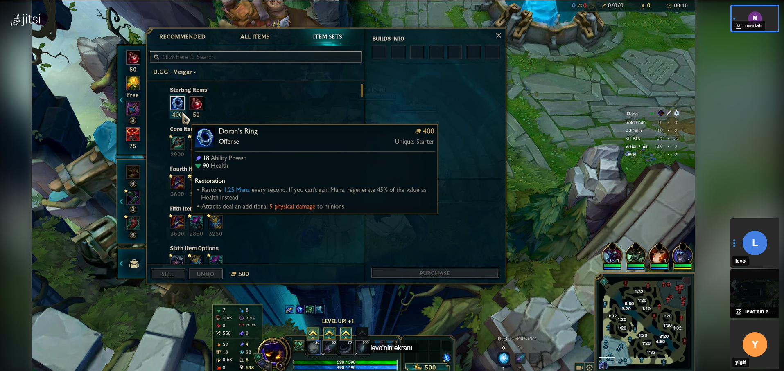

Slide 7
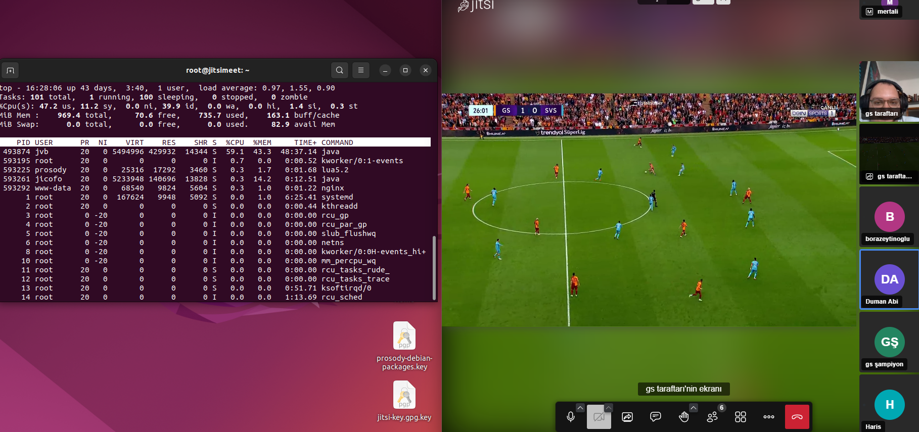
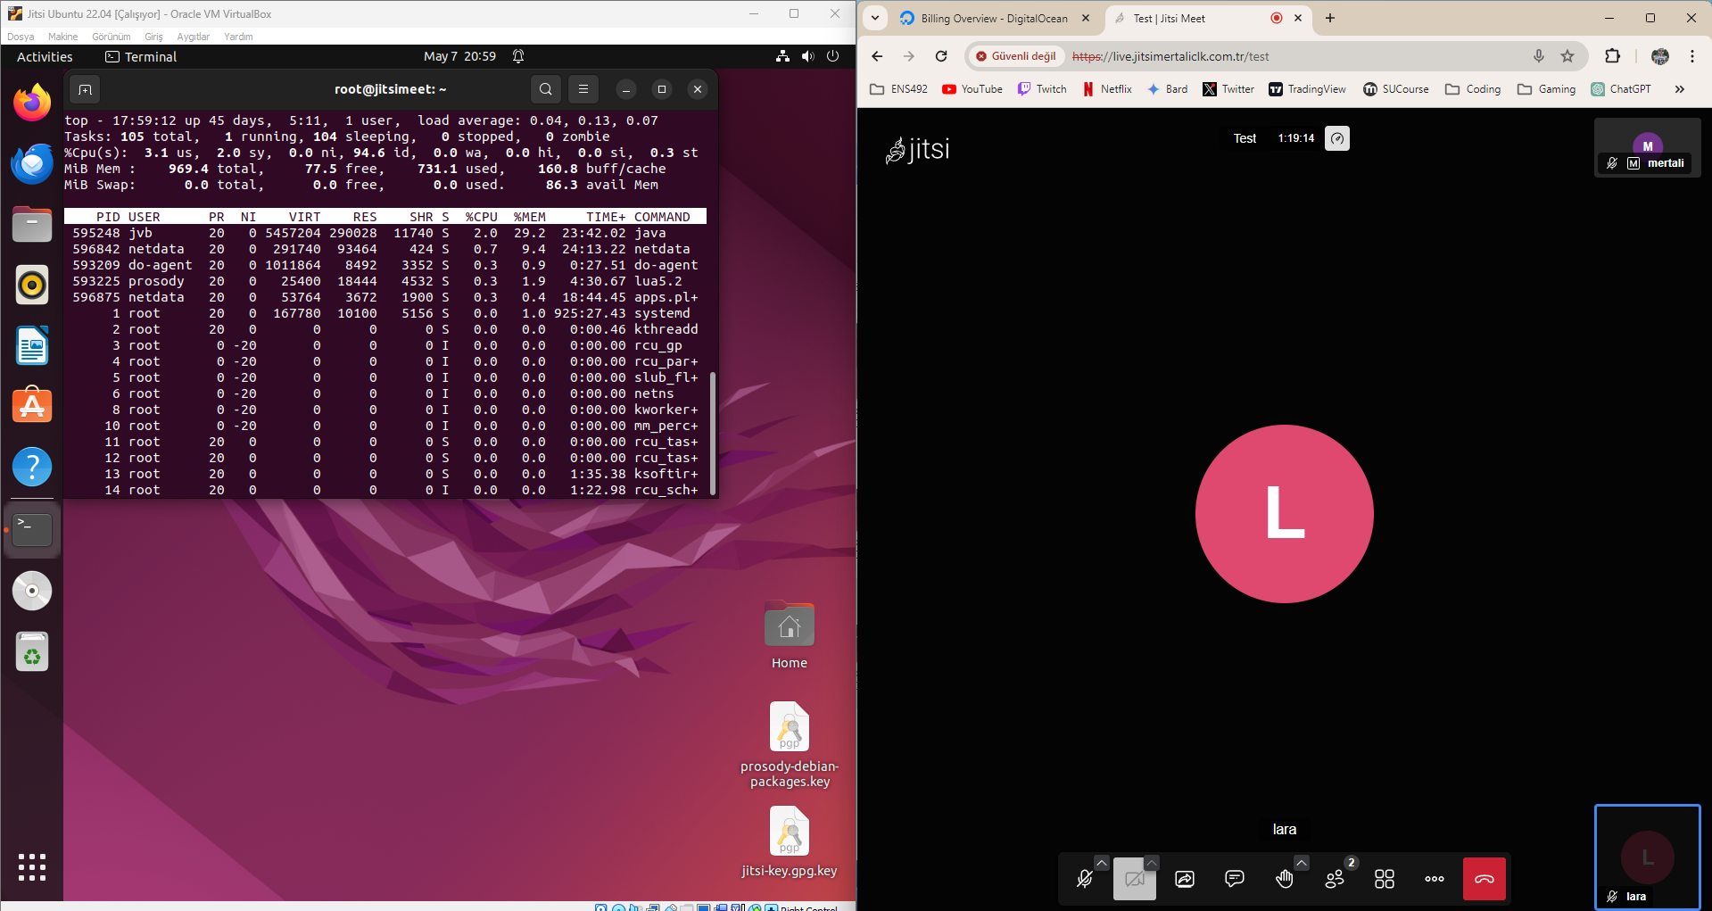
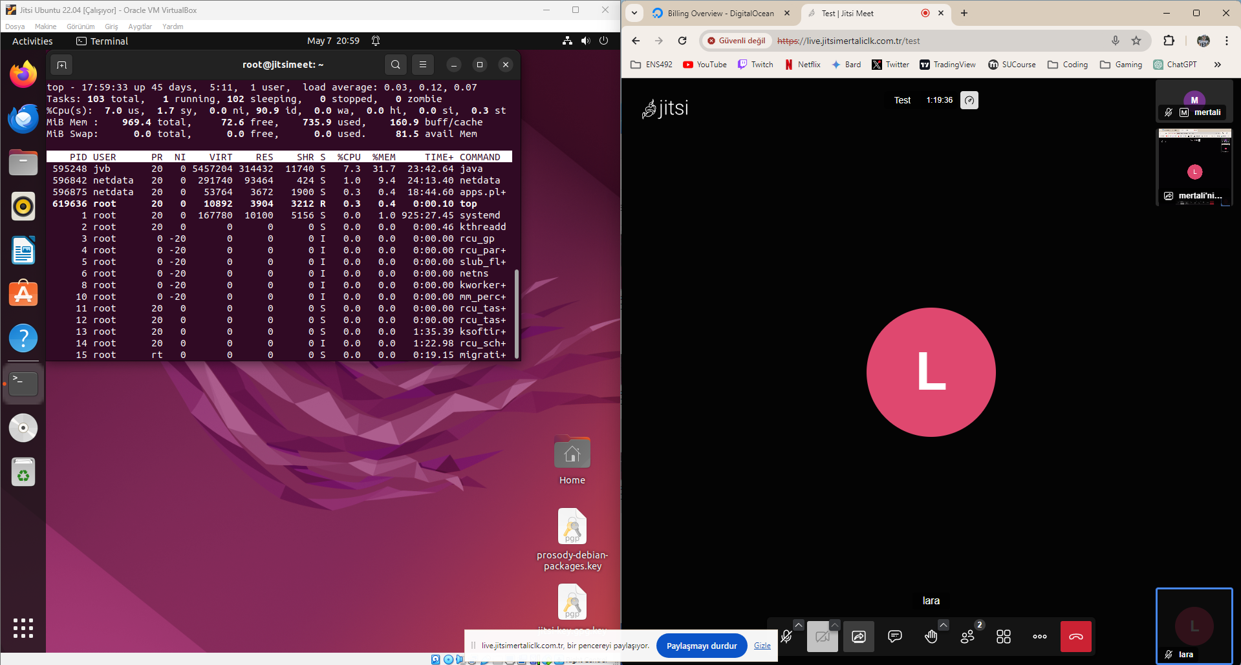
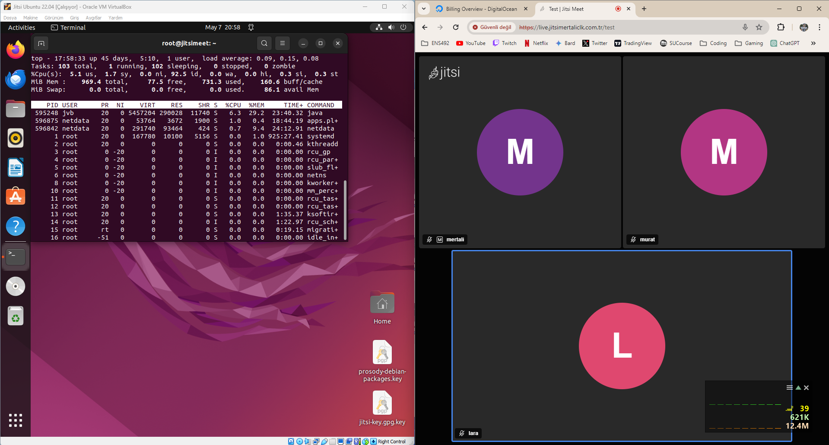

Slide 8
Realistic Constrainsts
Compatibility and Integration Challenges: Addressing compatibility issues between open-source tools and the Linux environment.
Compliance with Standards: Ensuring the software adheres to prevailing data security and privacy standards.
Skillset and Knowledge Requirements: Need for expertise in Linux and various programming languages. Continuous learning and application of new skills to meet project requirements.

Slide 9

Methodology
SELECTION AND CLONING OF OPEN-SOURCE SOFTWARE: JITSI MEET.
DEVELOPMENT ENVIRONMENT SETUP: LINUX-BASED SYSTEM, INSTALLATION CHALLENGES.
CUSTOMIZATION AND DEVELOPMENT: UI IMPROVEMENTS, FEATURE ENHANCEMENTS.
TESTING AND DOCUMENTATION: FUNCTIONAL, PERFORMANCE, AND SECURITY TESTING.

Slide 10
Testing Process
Installation and Configuration Testing: Verifying successful installation of the tools and dependencies on a Linux host.
Customization Testing: Ensuring the software meets all user requirements after tweaks and modifications.
Storage and Performance Testing: Assessing storage needs and performance during multiple simultaneous recording sessions.
Network Testing: Evaluating networking capabilities for handling multiple attendees .

Slide 11
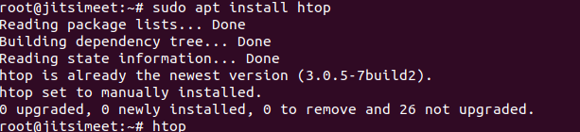
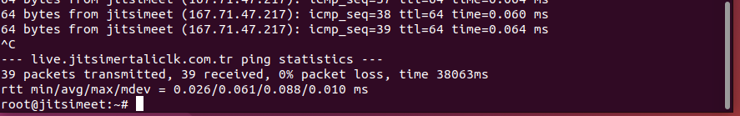
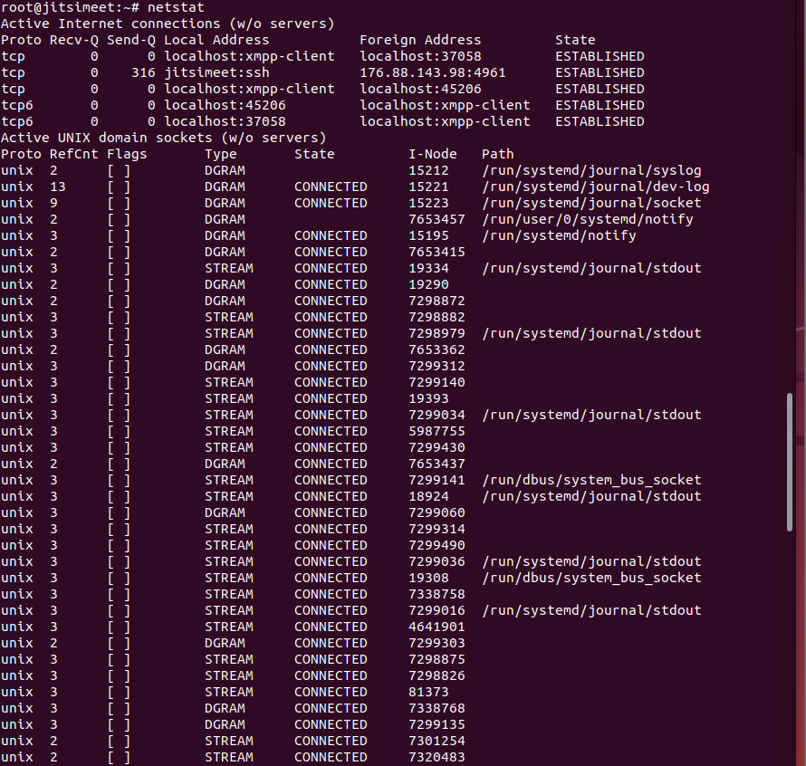
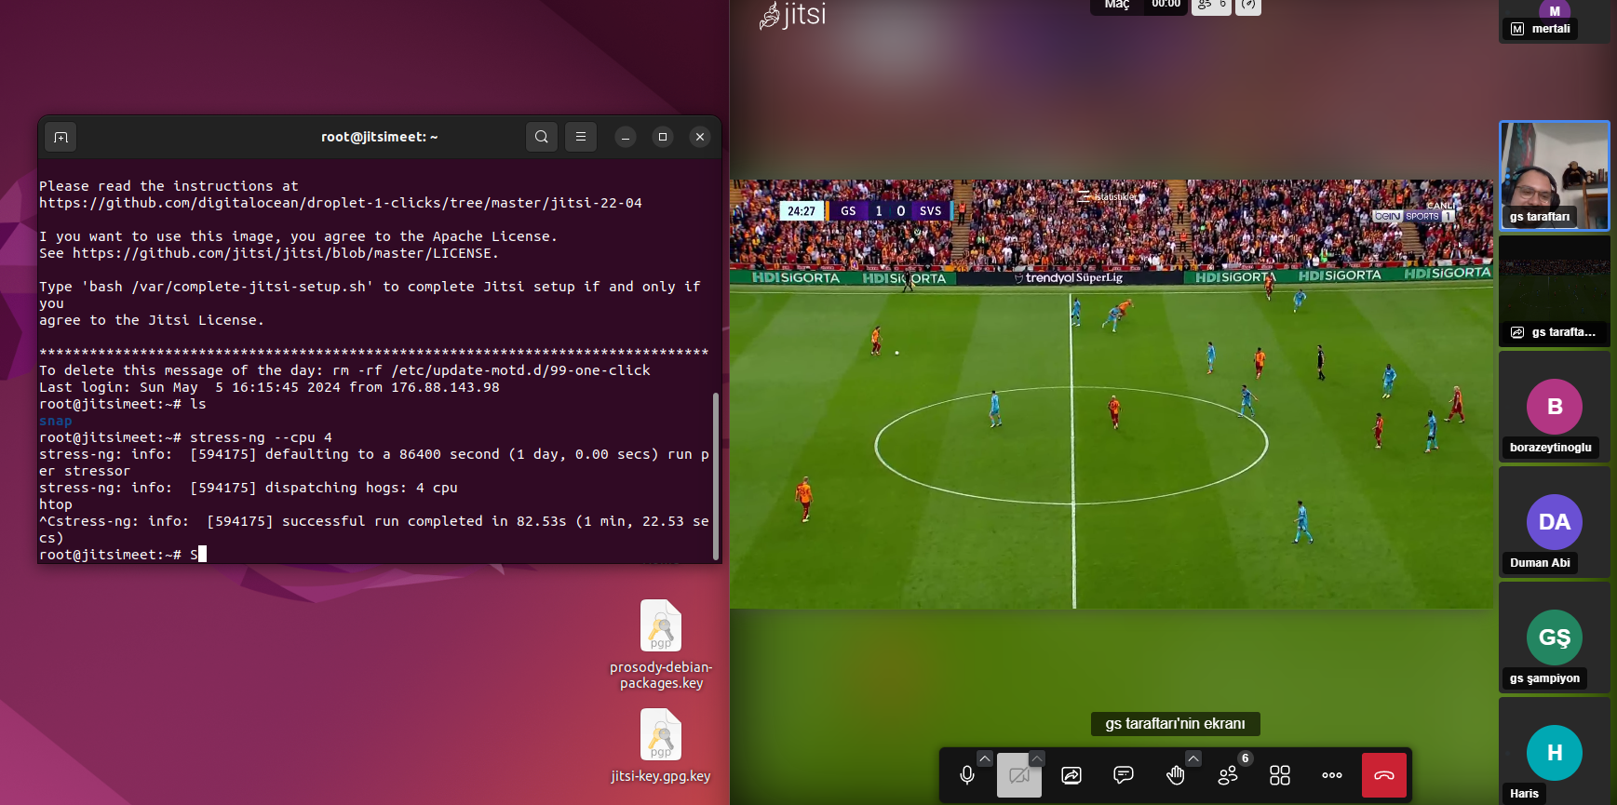

Slide 12
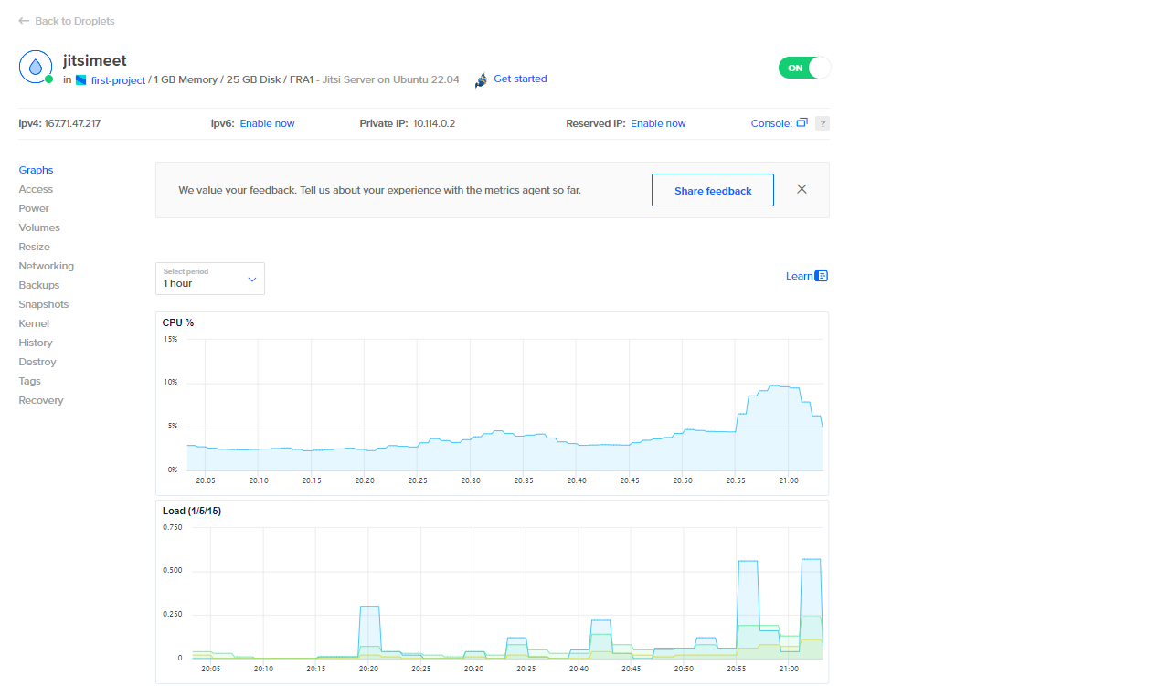
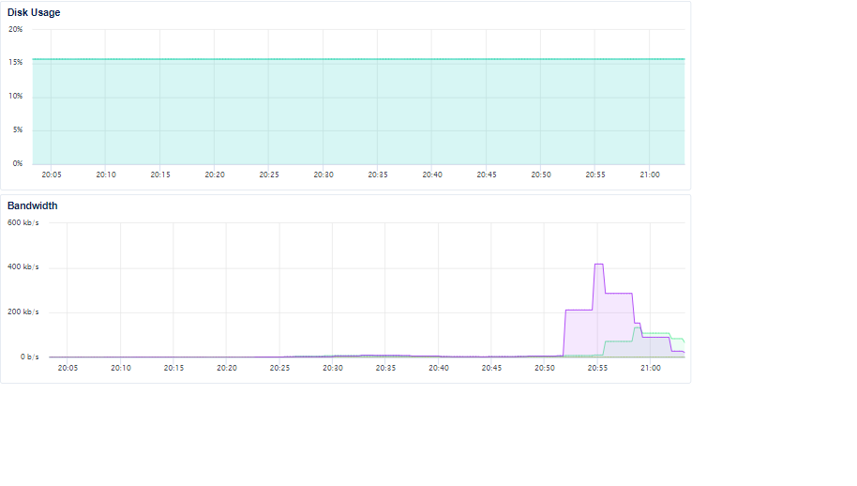
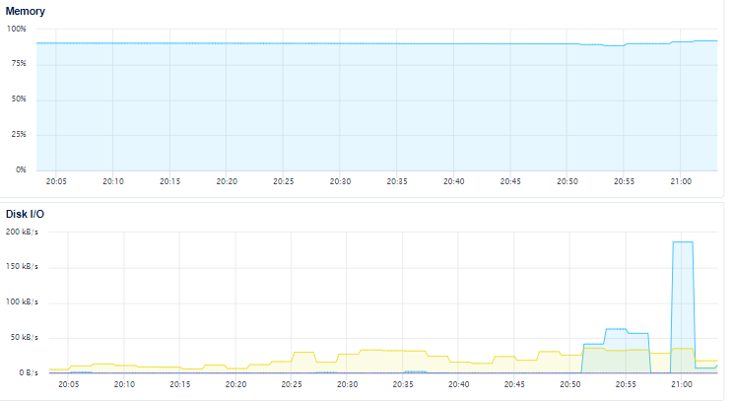

Slide 13

Results
Achievement of Objectives: Secure, scalable, user-friendly tool using Jitsi Meet.
Comparison with Initial Objectives: Emphasis on user authentication and data security.
Project Completion Status: Core functionalities in place, ongoing refinements.
Contribution to State-of-the-Art: Showcases open-source software potential in secure digital communications.

Slide 14

Impact
Scientific and Technological Impacts: Advancements in open-source technology and video conferencing.
Socio-Economic Impacts: Accessibility, cost-effectiveness, promotion of privacy and security awareness.
Innovative and Commercial Aspects: Customization services, foundation for future development.

Slide 15

References
Dudding, C. C. (2009). Digital Videoconferencing: Applications Across the Disciplines. Communication Disorders Quarterly, 30(3), 178–182.
Renfrew, M., Morton, D., Morton, J., Hinze, J., Beamish, P., Przybylko, G., & Craig, B. (2020). A Web- and Mobile App–Based Mental Health Promotion Intervention Comparing Email, Short Message Service, and Videoconferencing Support for a Healthy Cohort: Randomized Comparative Study. Journal of Medical Internet Research, 22(1), e15592.
https://github.com/jitsi/jitsi-meet
https://dashboard.ngrok.com/login?state=uIUZ1nKviOnteHRRePFo8iGsJCPBYv6ndgs4wVxNVBhh4OyjMhvrhNSy2Xzg7FyU8DrDtp4HNe25aYBGYJhQN6LkN2SW6hRJb3gkBOwDY49Eqzx3bqjT27BNqVNEU5TBNwqFgQE7E24h3QJDQE3Dj4Zy6GbzgBGBQXanx9GvwGtHtsHrmJ3vLWs%3D
https://cloud.digitalocean.com/databases?i=8ad8ef
https://app.metunic.com.tr/client/login/
https://www.namecheap.com/support/knowledgebase/article.aspx/10375/2208/how-do-i-link-a-domain-to-my-digitalocean-account/?_ga=2.133298830.1277036912.1710767761-1201122972.1710767761

